Slide 1
Intelligent Transportation System with Wireless Sensor Networks WSN Project
Alperen Gündogan
Besar Lami
Cagatay Moroglu
Kellerer, Wolfgang, Prof. Dr.-Ing.
wolfgang.kellerer@tum.de

Slide 2
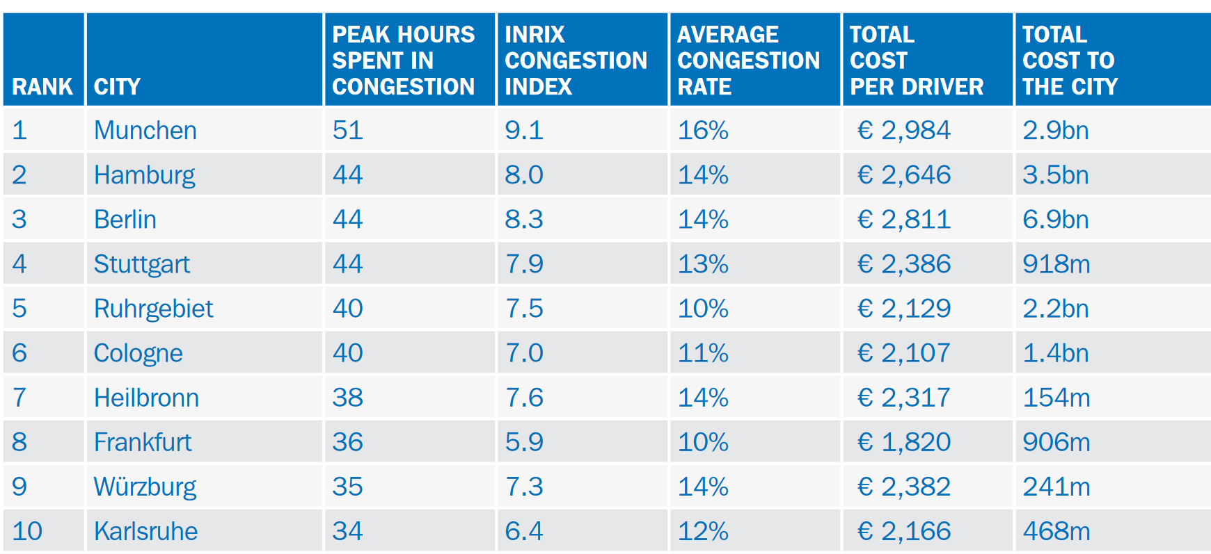
Motivation
The growth in the mobility → The increase in traffic congestion
many social, environmental and economic effects
In 2017, the people of Munich have spent the highest hours in congestion in Germany
Total cost of the congestion was almost 2.9 billion Euro for Munich. [1]
1

Slide 3
Motivation
The increasing traffic volume increases the risk of car accidents.
In 2017, 3180 people have died in Germany because of car accidents. [2]
Early medical intervention
Many approaches
to reduce the traffic congestion in roads
to intervene in emergencies as soon as possible
The emerging technologies of Wireless Sensor Networks revolutionized
traffic management, control
response to emergencies on the road
1

Slide 4
Overview
Introduction
Network Description and Routing Technique
Update Mechanism
Stability and robustness
Scenarios
Sectoral Localization
Accident Detection
GUI
Conclusion
1

Slide 5
Introduction
Intelligent Transportation System with Wireless Sensor Networks, by using Zolertia ™ Re-Mote wireless motes
support IEEE Std. 802.15.4 specification for Low-Rate Wireless Personal Area Networks(LR-WPANSs)
Aims
reduction of the cost by estimating traffic congestion on the road
Sense the accident as soon as possible
Early intervention to emergencies, saving more lives
Warn other cars on the road about the accident
Characteristics of the network
Low delay
High reliability
The first thing we need to provide clear communication between nodes is the routing.
1

Slide 6
Network Description and Routing Technique
Destination-Sequenced Distance Vector(DSDV)
DSDV is proactive(table-driven) routing algorithm which is based on Bellman-Ford algorithm.
Shortest path routing based on total hop number.
Each mote contains routing table for the other motes in the network.
The routing entries contain the following pieces of information:
The destination’s address.
The next hop address.
The number of hops to reach the destination.
Metric (weighted RSSI)
The sequence number which is originated by the destination mote and increased by 2 in each periodic update.
DSDV uses sequence number to encounter count-to-infinity problem.
Odd sequence number indicates failed links, whereas even sequence number indicates valid link.
Network always converges to higher sequence number.
1
Notes:
The Bellman–Ford algorithm does not prevent routing loops from happening and suffers from the count-to-infinity problem. The core of the count-to-infinity problem is that if A tells B that it has a path somewhere, there is no way for B to know if the path has B as a part of it. To see the problem clearly, imagine a subnet connected like A–B–C–D–E–F, and let the metric between the routers be "number of jumps". Now suppose that A is taken offline. In the vector-update-process B notices that the route to A, which was distance 1, is down – B does not receive the vector update from A. The problem is, B also gets an update from C, and C is still not aware of the fact that A is down – so it tells B that A is only two jumps from C (C to B to A), which is false. Since B doesn't know that the path from C to A is through itself (B), it updates its table with the new value "B to A = 2 + 1". Later on, B forwards the update to C and due to the fact that A is reachable through B (From C's point of view), C decides to update its table to "C to A = 3 + 1". This slowly propagates through the network until it reaches infinity (in which case the algorithm corrects itself, due to the relaxation property of Bellman–Ford)

Slide 7
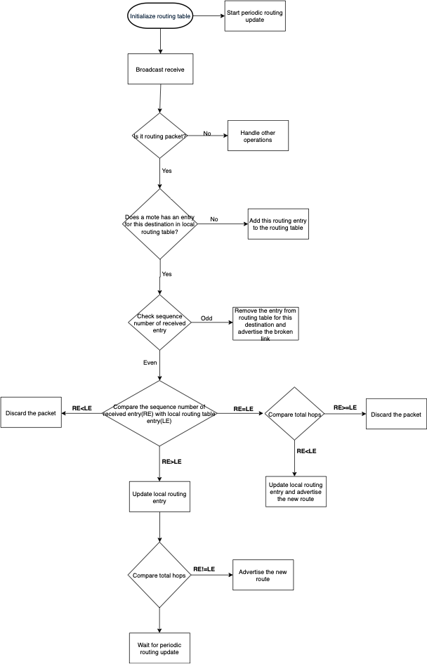
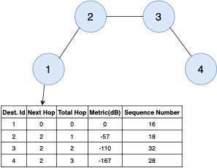
Network Description and Routing Technique
Update Mechanism
Full routing table update:
Each mote in the network broadcasts its routing table periodically e.g. 15 sec.
Triggered update:
If a link in the network changes i.e. finds a better route, failure detection, a mote sends this update to other motes without waiting full routing table update.
1

Slide 8
Initialize motes
Dest. ID | Next Hop | Total Hop | Metric(dB) | Seq. No
2 | 0 | 0 | 0 | 0
Dest. ID | Next Hop | Total Hop | Metric(dB) | Seq. No
4 | 0 | 0 | 0 | 0
1
2
3
4
Dest. ID | Next Hop | Total Hop | Metric(dB) | Seq. No
1 | 0 | 0 | 0 | 0
Dest. ID | Next Hop | Total Hop | Metric(dB) | Seq. No
3 | 0 | 0 | 0 | 0
1

Slide 9
After first periodic update
New route
Triggered Update!!!
Dest. ID | Next Hop | Total Hop | Metric(dB) | Seq. No
2 | 0 | 0 | 0 | 2
1 | 1 | 1 | -57 | 2
3 | 3 | 1 | -60 | 2
Dest. ID | Next Hop | Total Hop | Metric(dB) | Seq. No
4 | 0 | 0 | 0 | 2
3 | 3 | 1 | -54 | 2
New routes
Triggered Update!!!
1
2
3
4
Dest. ID | Next Hop | Total Hop | Metric(dB) | Seq. No
1 | 0 | 0 | 0 | 2
2 | 2 | 1 | -58 | 2
Dest. ID | Next Hop | Total Hop | Metric(dB) | Seq. No
3 | 0 | 0 | 0 | 2
2 | 2 | 1 | -61 | 2
4 | 3 | 1 | -52 | 2
New route
Triggered Update!!!
New routes
Triggered Update!!!
1

Slide 10
After the triggered update
Dest. ID | Next Hop | Total Hop | Metric(dB) | Seq. No
2 | 0 | 0 | 0 | 2
1 | 1 | 1 | -57 | 2
3 | 3 | 1 | -60 | 2
4 | 3 | 2 | -120 | 2
New route
Triggered Update!!!
Dest. ID | Next Hop | Total Hop | Metric(dB) | Seq. No
4 | 0 | 0 | 0 | 2
3 | 3 | 1 | -54 | 2
2 | 3 | 2 | -116 | 2
New route
Triggered Update!!!
1
2
3
4
Dest. ID | Next Hop | Total Hop | Metric(dB) | Seq. No
1 | 0 | 0 | 0 | 2
2 | 2 | 1 | -58 | 2
3 | 2 | 2 | -112 | 2
Dest. ID | Next Hop | Total Hop | Metric(dB) | Seq. No
3 | 0 | 0 | 0 | 2
2 | 2 | 1 | -61 | 2
4 | 4 | 1 | -52 | 2
1 | 2 | 2 | -110 | 2
New route
Triggered Update!!!
New route
Triggered Update!!!
1

Slide 11
After the triggered update
Dest. ID | Next Hop | Total Hop | Metric(dB) | Seq. No
2 | 0 | 0 | 0 | 2
1 | 1 | 1 | -57 | 2
3 | 3 | 1 | -60 | 2
4 | 3 | 2 | -120 | 2
Dest. ID | Next Hop | Total Hop | Metric(dB) | Seq. No
4 | 0 | 0 | 0 | 2
3 | 3 | 1 | -54 | 2
2 | 3 | 2 | -116 | 2
1 | 3 | 3 | -170 | 2
New route
Triggered Update!!!
1
2
3
4
Dest. ID | Next Hop | Total Hop | Metric(dB) | Seq. No
1 | 0 | 0 | 0 | 2
2 | 2 | 1 | -58 | 2
3 | 2 | 2 | -112 | 2
4 | 2 | 3 | -174 | 2
Dest. ID | Next Hop | Total Hop | Metric(dB) | Seq. No
3 | 0 | 0 | 0 | 2
2 | 2 | 1 | -61 | 2
4 | 4 | 1 | -52 | 2
1 | 2 | 2 | -110 | 2
New route
Triggered Update!!!
1

Slide 12
Link Failure after some time
Dest. ID | Next Hop | Total Hop | Metric(dB) | Seq. No
2 | 0 | 0 | 0 | 28
1 | 1 | 1 | -57 | 28
3 | 3 | 1 | -60 | 28
4 | 3 | 2 | -120 | 28
Dest. ID | Next Hop | Total Hop | Metric(dB) | Seq. No
4 | 0 | 0 | 0 | 28
3 | 3 | 1 | -54 | 28
2 | 3 | 2 | -116 | 28
1 | 3 | 3 | -170 | 28
1
Mote 3 does not receive
periodic update message
from mote 4.
1
2
3
4
Dest. ID | Next Hop | Total Hop | Metric(dB) | Seq. No
1 | 0 | 0 | 0 | 28
2 | 2 | 1 | -58 | 28
3 | 2 | 2 | -112 | 28
4 | 2 | 3 | -174 | 28
Dest. ID | Next Hop | Total Hop | Metric(dB) | Seq. No
3 | 0 | 0 | 0 | 28
2 | 2 | 1 | -61 | 28
4 | ∞ | ∞ | ∞ | 29
1 | 2 | 2 | -110 | 28
2
Updates sequence number
of mote 4 by 1 and advertise this entry.
1

Slide 13
Link Failure Convergence
Dest. ID | Next Hop | Total Hop | Metric(dB) | Seq. No
2 | 0 | 0 | 0 | 28
1 | 1 | 1 | -57 | 28
3 | 3 | 1 | -60 | 28
4 | ∞ | ∞ | ∞ | 29
Dest. ID | Next Hop | Total Hop | Metric(dB) | Seq. No
4 | 0 | 0 | 0 | 28
3 | 3 | 1 | -54 | 28
2 | 3 | 2 | -116 | 28
1 | 3 | 3 | -170 | 28
1
2
3
4
Dest. ID | Next Hop | Total Hop | Metric(dB) | Seq. No
1 | 0 | 0 | 0 | 28
2 | 2 | 1 | -58 | 28
3 | 2 | 2 | -112 | 28
4 | ∞ | ∞ | ∞ | 29
Dest. ID | Next Hop | Total Hop | Metric(dB) | Seq. No
3 | 0 | 0 | 0 | 28
2 | 2 | 1 | -61 | 28
4 | ∞ | ∞ | ∞ | 29
1 | 2 | 2 | -110 | 28
1

Slide 14
Damping Fluctuations
Longer path
What are Fluctuations?
In some cases, due to interference among motes or difference in periodic routing update intervals, update of mote 1 can reach earlier from longer path.
4 Hops
[1, …, 4, 58]
New update!
7
[1, 0, 0, 58]
1
9
t=0ms
3
Hops
Dest. ID | Next Hop | Total Hop | Metric(dB) | Seq. No
9 | 0 | 0 | 0 | 34
1 | 8 | 4 | -202 | 56
… | … | … | … | …
8
Established shortest route
1

Slide 15
Damping Fluctuations
Longer path
New update!
4 Hops
7
[1, 0, 0, 58]
1
9
[1, 7, 5, 58]
t=1ms
3
Hops
[1, …, 3, 58]
Dest. ID | Next Hop | Total Hop | Metric(dB) | Seq. No
9 | 0 | 0 | 0 | 34
1 | 7 | 5 | -254 | 58
… | … | … | … | …
8
Established shortest route
Route for destination mote 1 has changed.
I should advertise this to other motes in the network immediately.
1

Slide 16
Damping Fluctuations
Longer path
New update!
4 Hops
7
[1, 0, 0, 58]
1
[1, 8, 4, 58]
9
t=2ms
3
Hops
Dest. ID | Next Hop | Total Hop | Metric(dB) | Seq. No
9 | 0 | 0 | 0 | 34
1 | 8 | 4 | -202 | 58
… | … | … | … | …
8
Established shortest route
I got better/shorter route for mote 1 with the same sequence number,
I should reach mote 1 via this route advertise this to other motes.
1

Slide 17
Damping Fluctuations
This leads to unnecessary route advertisements, so called fluctuations.
How can we avoid this?
Solution: Settling time
Motes wait for predefined interval, settling time, before they advertise a new route.
In this way, only stable routes will be advertised to the network.
The overhead will be reduced and the network becomes more stable.
1

Slide 18
Failure Recovery Mechanism
What happens if a mote restarts or rejoin the network after it has removed?
The mote synchronizes itself with the highest sequence number that is used in the network and start to count from this number.
Weighted RSSI
In order to dampen the high oscillations of the RSSI measure the routing algorithm implements a Weighted Sum mechanism.
The weights of the sum are stored in the weight vector W = [w₁,w₂]
Formula: RSSI_{weighted} = RSSI_{old} * w₁ + RSSI_{new} * w₂
Depending on the network mobility and convergence time different values of W can be used.
17

Slide 19
DSDV: Advantages & Disadvantages
(+) DSDV guarantees loop free path.
(+) DSDV outperforms the other routing algorithms in terms of end-to-end delay and normalize routing load(NRL)[3].
(-) DSDV requires periodic updates which reduces battery life.
(-) Small amount of bandwidth is allocated even when the network is idle.
17

Slide 20
Scenarios
Two main scenarios:
Sectoral Localization
to calculate the number of cars on each sector of the road
Accident Detection
to inform everyone on the road, including the traffic center
to create a direct communication channel between the traffic center and the crashed car for the early intervention

Slide 21
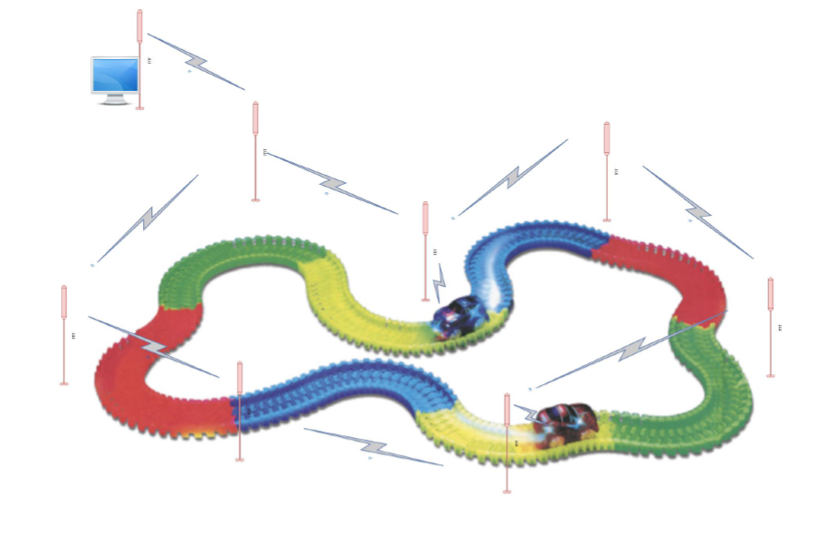
Sectoral Localization
Motes are placed on the roadside at regular intervals
are equipped with IR Distance sensor.
to detect on object
When a RSU senses an object, it increments its counter by 1.
sends the counter to the traffic center
when it senses an object
periodically
With the help of these counters, the traffic center calculates the number of cars on each sector of the road.

Slide 22
Accident Detection
Each car on the road is equipped with a wireless mote
integrated with a force sensor
which is able to sense the crash
If a mote senses a crash, it informs everyone on the network with a crash message
each RSU receiving this crash message rebroadcasts it with a controlled rebroadcast mechanism to avoid broadcast storm
As soon as this car detects the collision, after broadcasting the collision message, it will enable its routing algorithm
to involve on the network of RSUs
When the traffic center has the crashed MU in its routing table
can create a multi-hop communication channel to the passengers in the car
learn the details of the accident

Slide 23
Graphical User Interface
GUI is used to :
Visualize the routing table
Display sectors and sector object count
Display temperature and battery level of the RSU
Display collision warning messages
Send and receive messages from the collided MU
Reset the collided MU after accident is resolved
GUI will be explained by means of an example case in the following slides

Slide 24
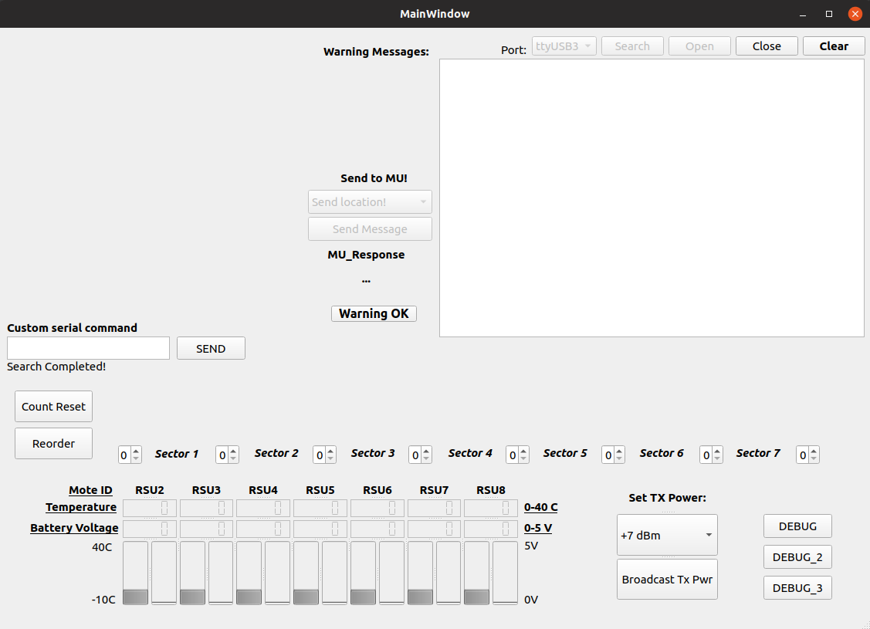
Graphical User Interface
Search and Open a serial port
19

Slide 25

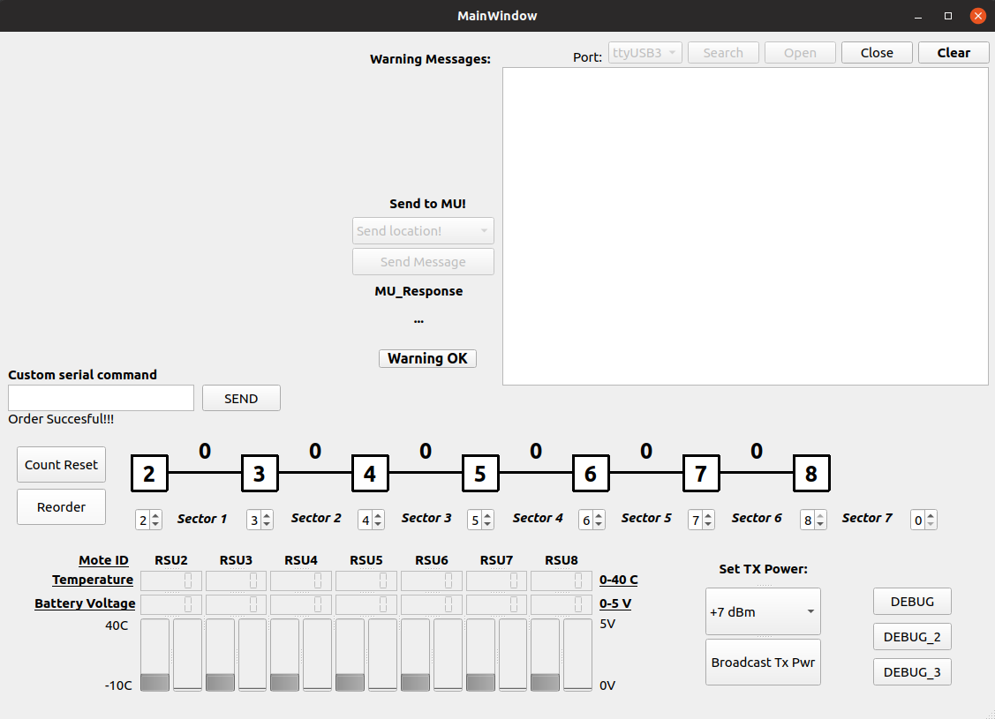
Graphical User Interface
Order the sectors
Sector and sector count
Kellerer, Wolfgang, Prof. Dr.-Ing. (TUM) | WSN Winter 18 | Final Project
19

Slide 26
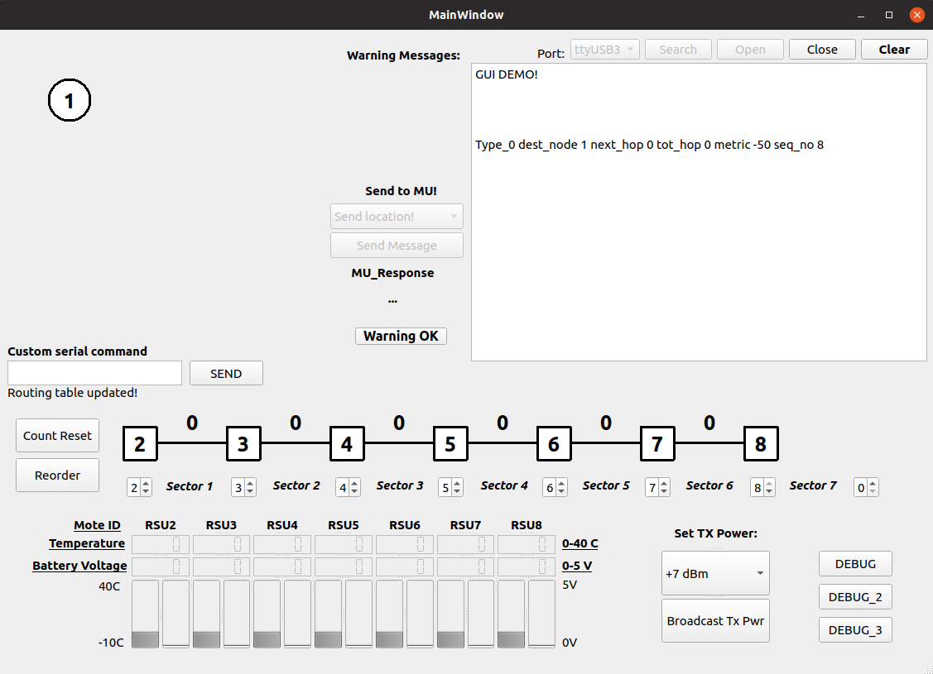
White Node = USB Connected Mote
Routing Visualization
Serial port dump
Kellerer, Wolfgang, Prof. Dr.-Ing. (TUM) | WSN Winter 18 | Final Project
19

Slide 27
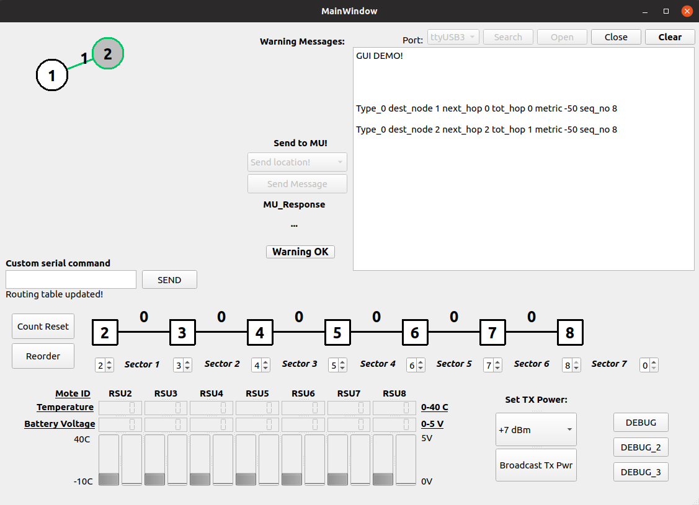
Green Node = 1 Hop Connected Mote
Kellerer, Wolfgang, Prof. Dr.-Ing. (TUM) | WSN Winter 18 | Final Project
19

Slide 28
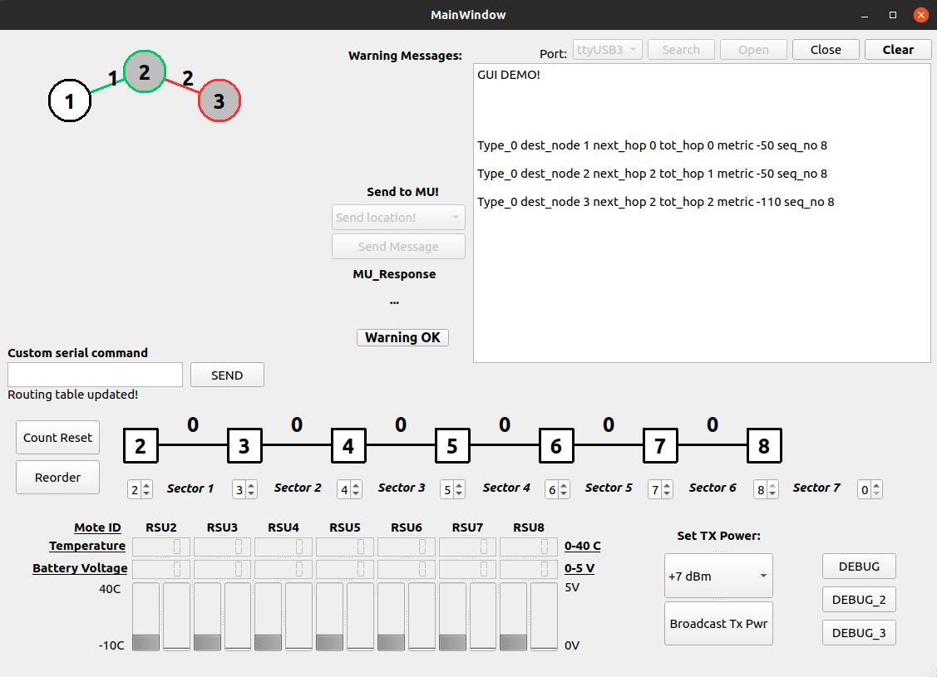
Red Node = Multi Hop Connected Mote
Kellerer, Wolfgang, Prof. Dr.-Ing. (TUM) | WSN Winter 18 | Final Project
19

Slide 29
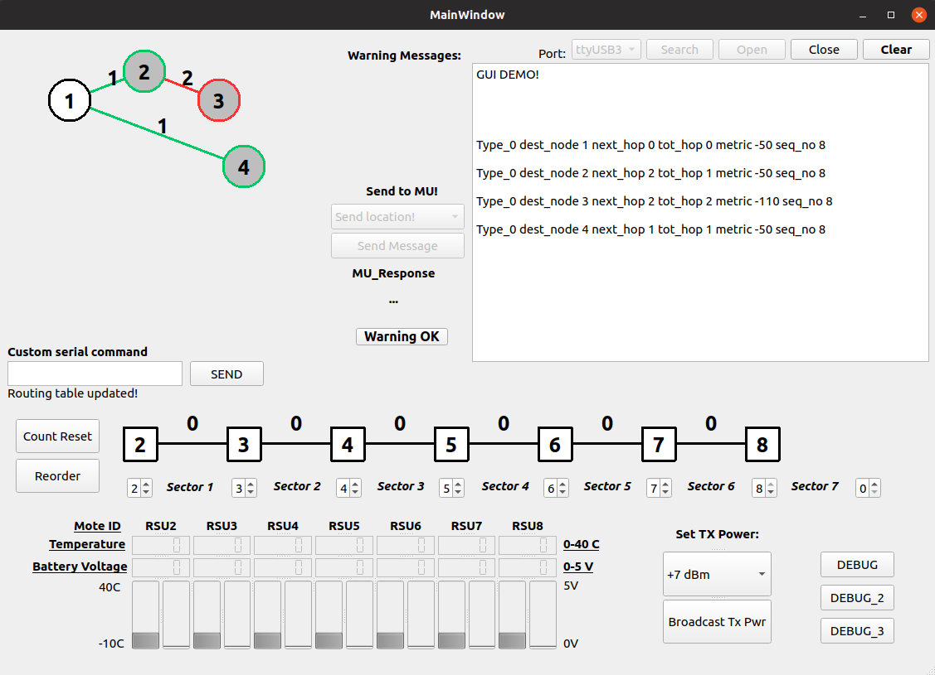
Total Hop Count
Kellerer, Wolfgang, Prof. Dr.-Ing. (TUM) | WSN Winter 18 | Final Project
19

Slide 30
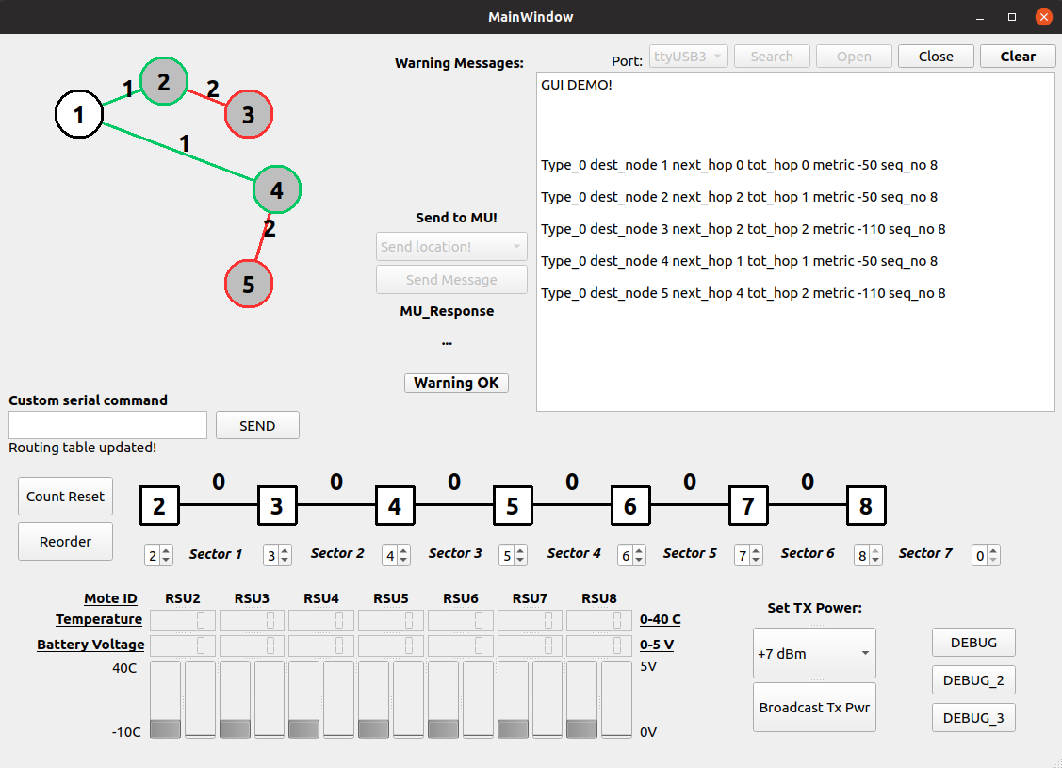
Graphical User Interface
Updated graph
<--- New information
Kellerer, Wolfgang, Prof. Dr.-Ing. (TUM) | WSN Winter 18 | Final Project
19

Slide 31
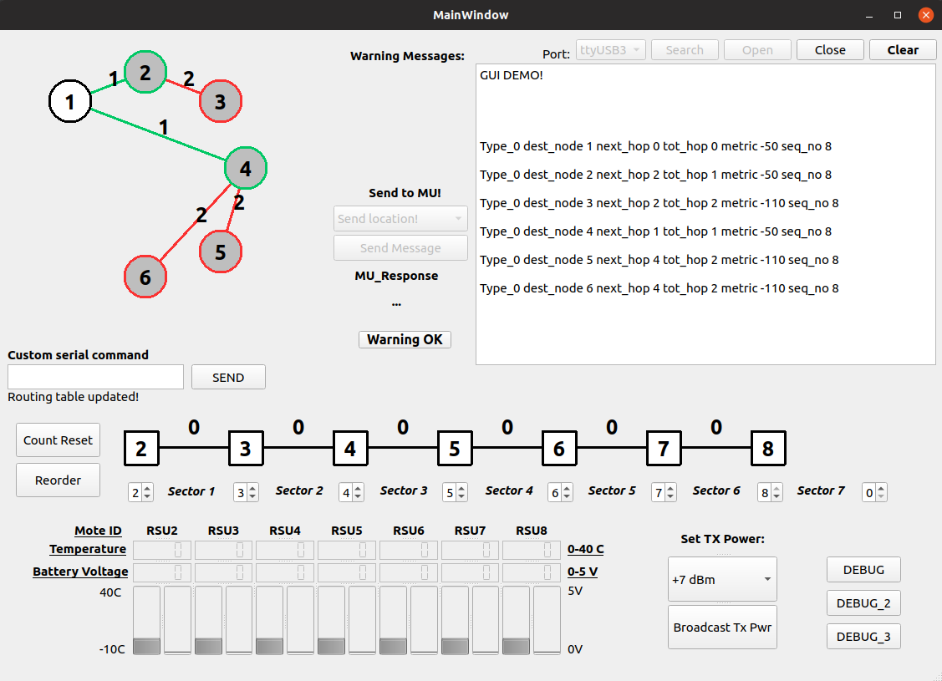
Graphical User Interface
Kellerer, Wolfgang, Prof. Dr.-Ing. (TUM) | WSN Winter 18 | Final Project
19

Slide 32
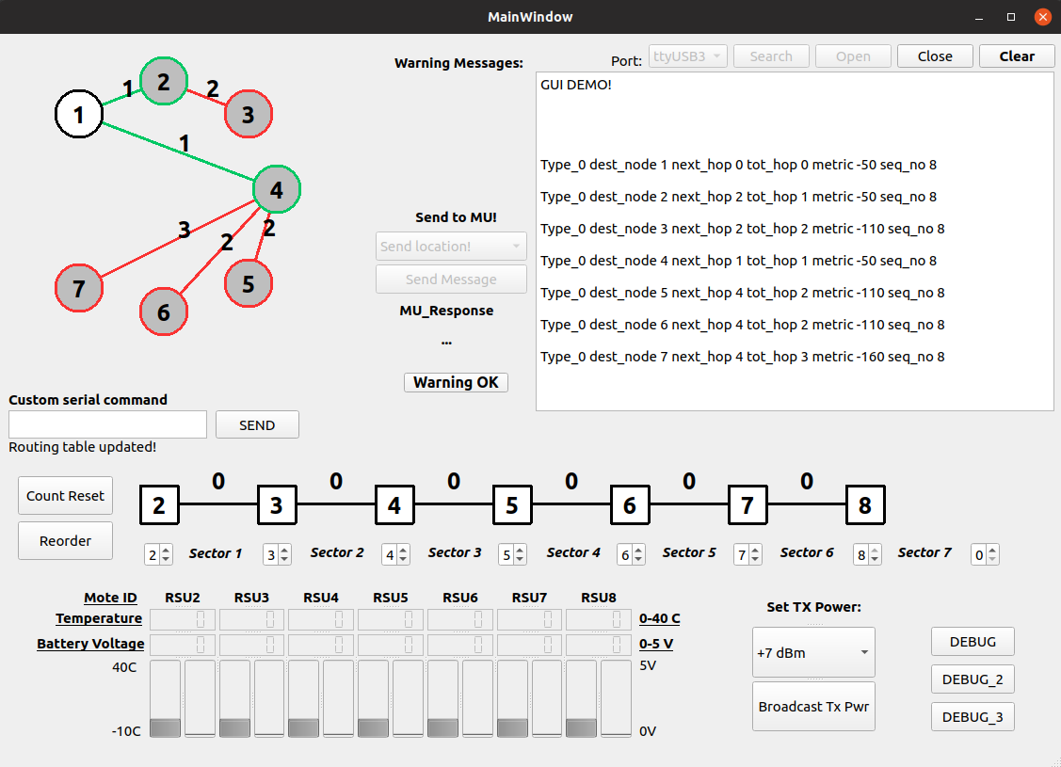
Graphical User Interface
Kellerer, Wolfgang, Prof. Dr.-Ing. (TUM) | WSN Winter 18 | Final Project
19

Slide 33
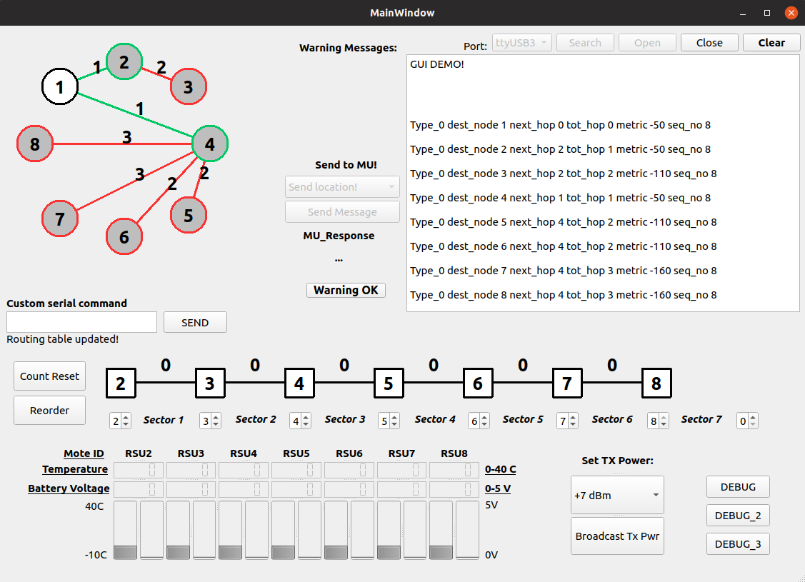
Graphical User Interface
Graph Done
Kellerer, Wolfgang, Prof. Dr.-Ing. (TUM) | WSN Winter 18 | Final Project
19

Slide 34
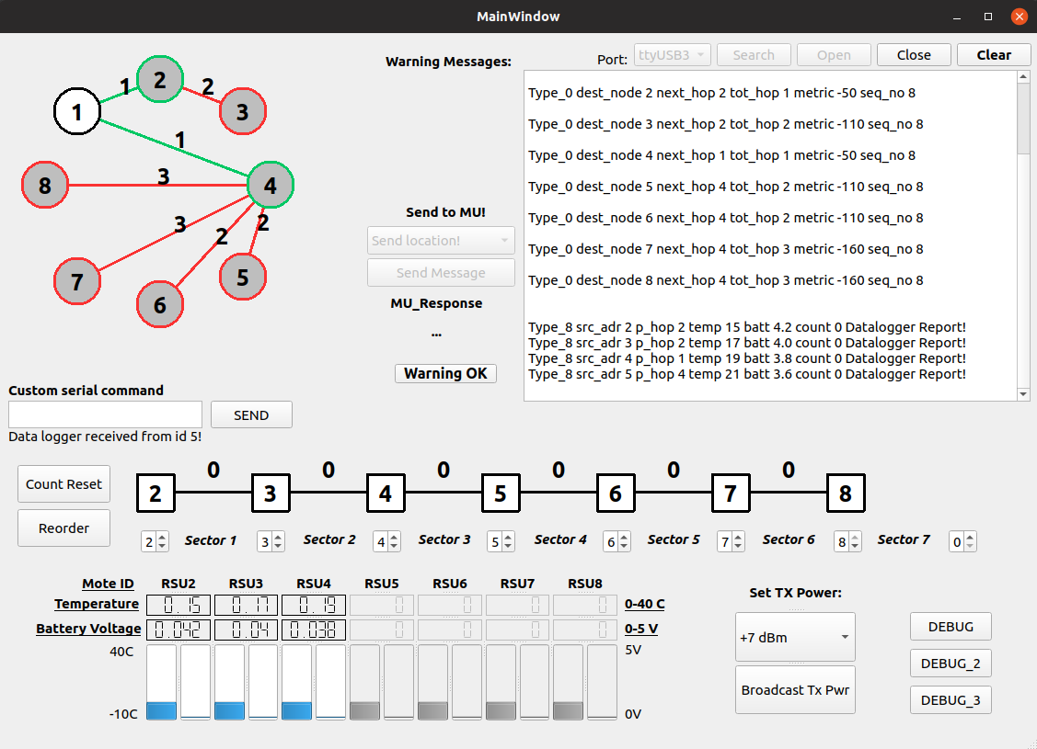
Graphical User Interface
Data-logger Display
Updated by mote periodic messages
Kellerer, Wolfgang, Prof. Dr.-Ing. (TUM) | WSN Winter 18 | Final Project
19

Slide 35
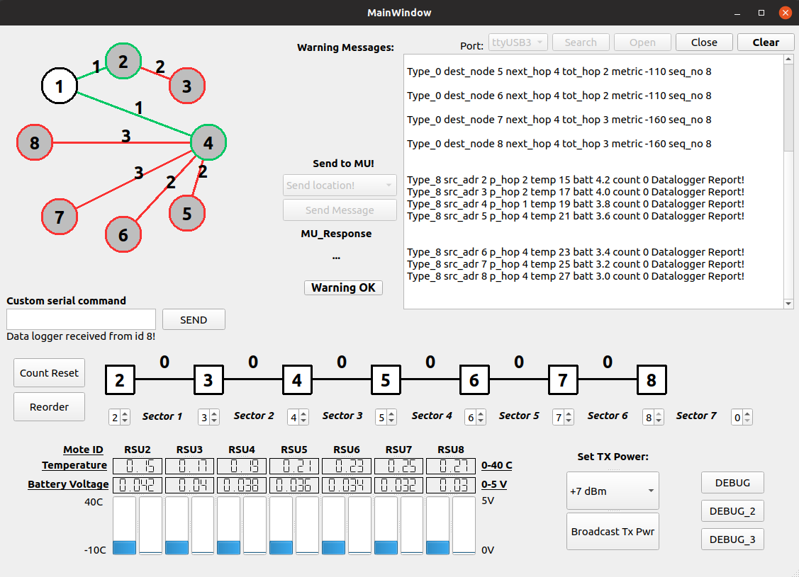
Graphical User Interface
Data-logger messages
Kellerer, Wolfgang, Prof. Dr.-Ing. (TUM) | WSN Winter 18 | Final Project
19

Slide 36
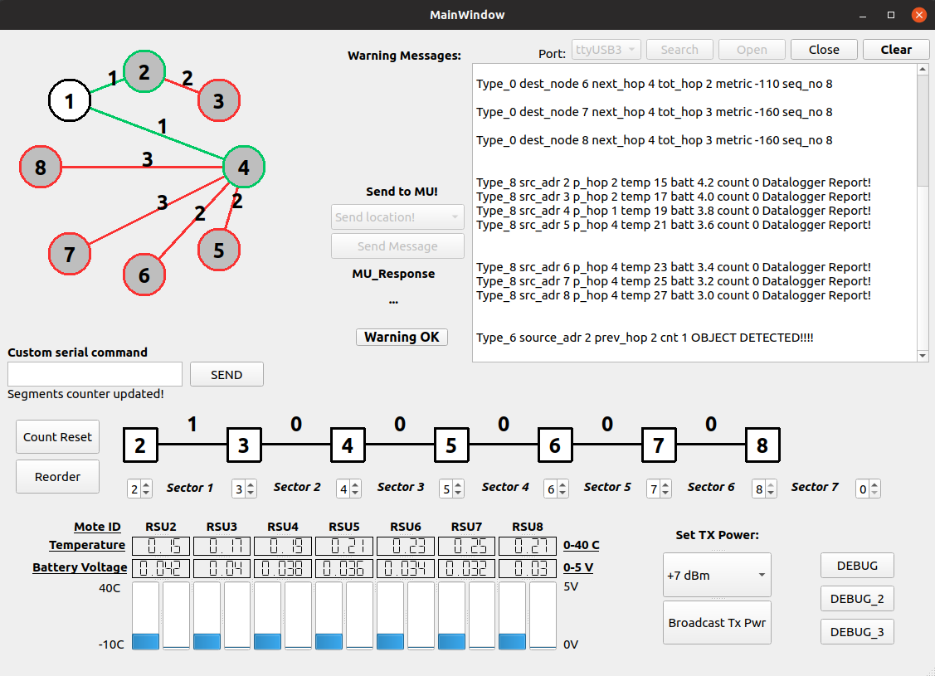
Graphical User Interface
Object Detected
Kellerer, Wolfgang, Prof. Dr.-Ing. (TUM) | WSN Winter 18 | Final Project
19

Slide 37
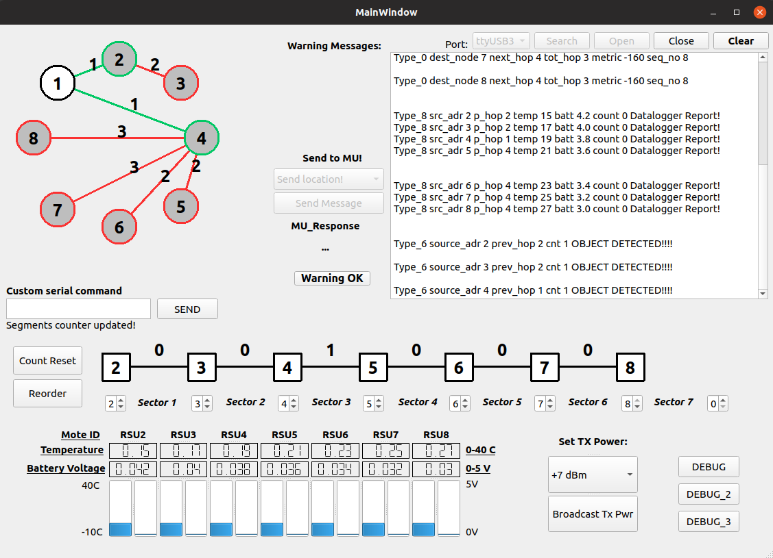
Graphical User Interface
Sectorial Localization
Kellerer, Wolfgang, Prof. Dr.-Ing. (TUM) | WSN Winter 18 | Final Project
19

Slide 38
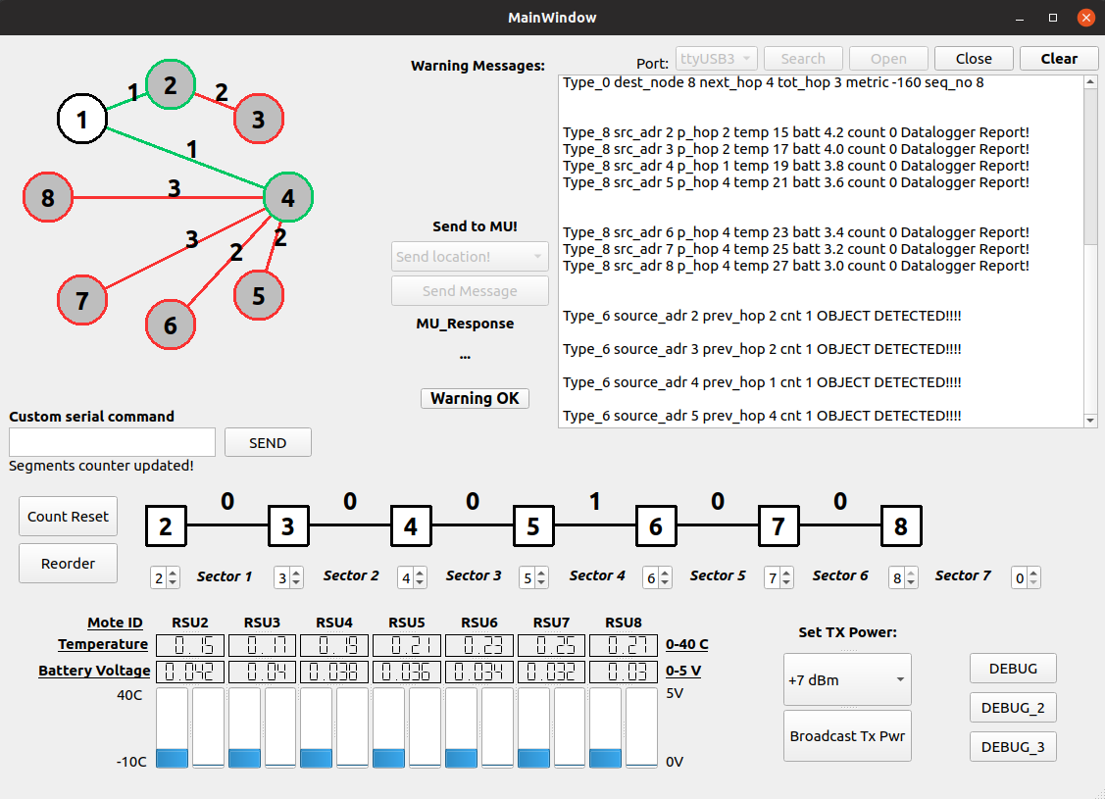
Graphical User Interface
Kellerer, Wolfgang, Prof. Dr.-Ing. (TUM) | WSN Winter 18 | Final Project
19

Slide 39
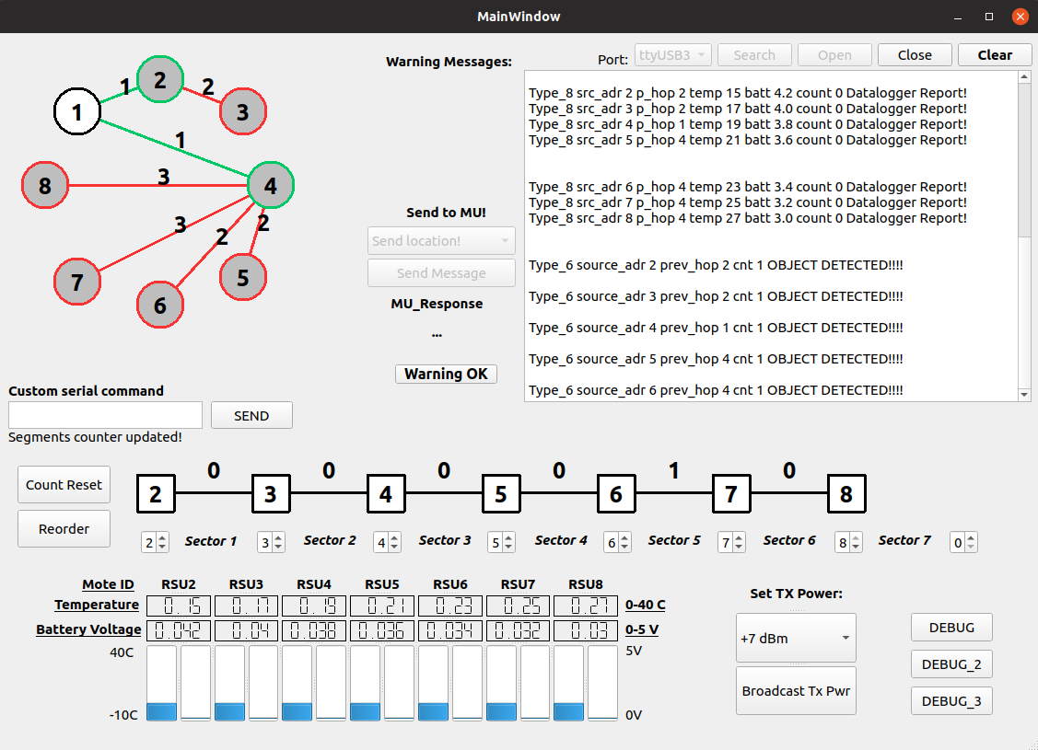
Graphical User Interface
Kellerer, Wolfgang, Prof. Dr.-Ing. (TUM) | WSN Winter 18 | Final Project
19

Slide 40
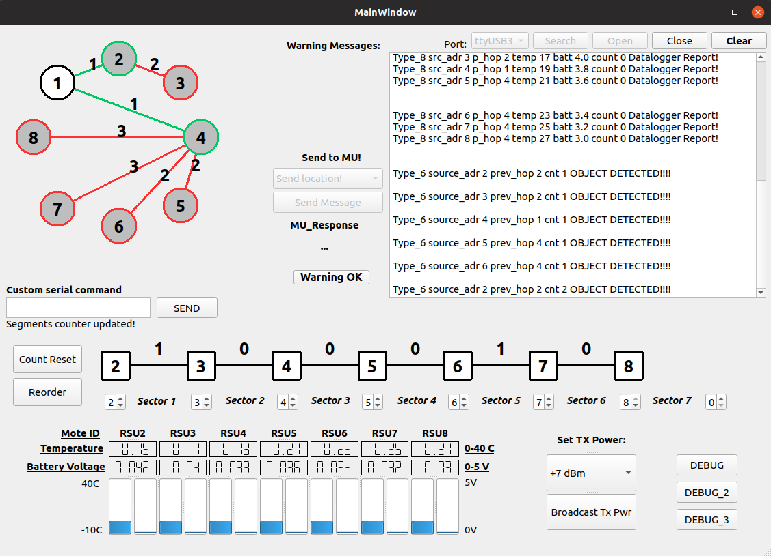
Graphical User Interface
Kellerer, Wolfgang, Prof. Dr.-Ing. (TUM) | WSN Winter 18 | Final Project
19

Slide 41
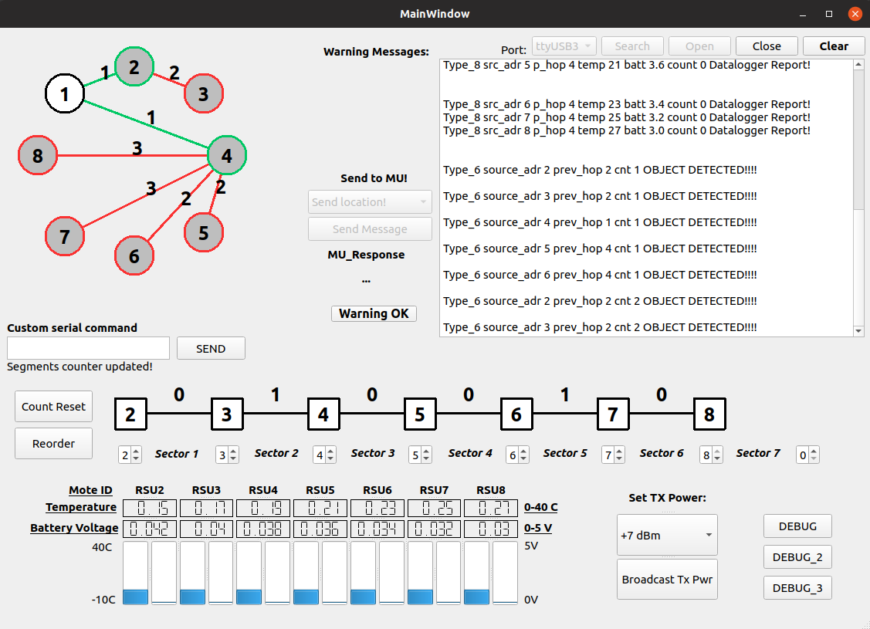
Graphical User Interface
2 Objects Propagating
Kellerer, Wolfgang, Prof. Dr.-Ing. (TUM) | WSN Winter 18 | Final Project
19

Slide 42

Graphical User Interface
Kellerer, Wolfgang, Prof. Dr.-Ing. (TUM) | WSN Winter 18 | Final Project
19

Slide 43
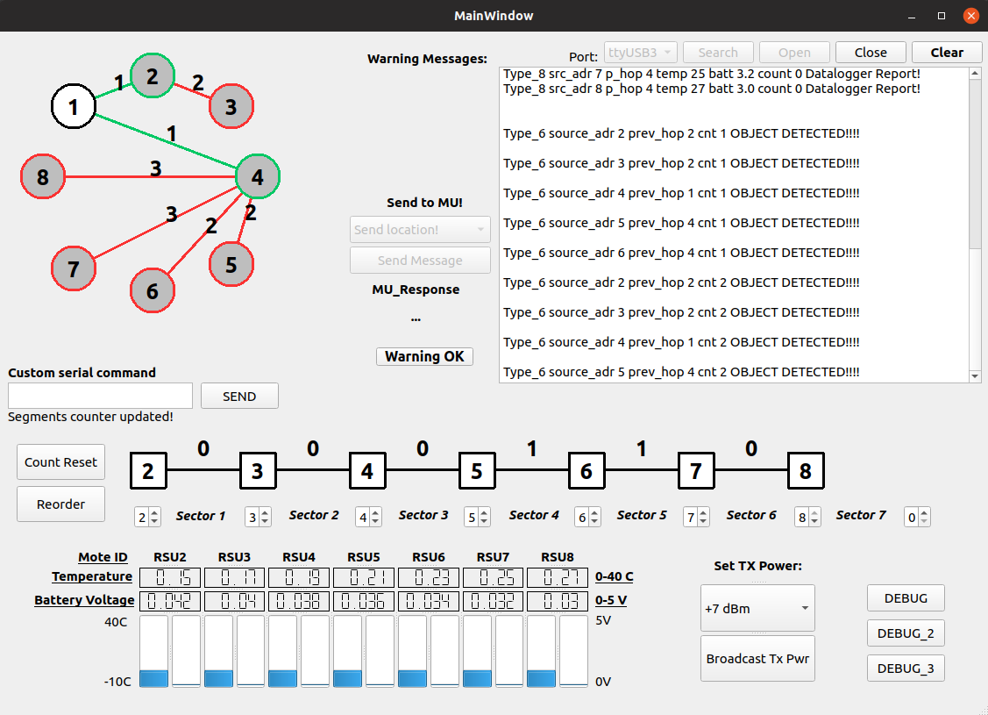
Graphical User Interface
Kellerer, Wolfgang, Prof. Dr.-Ing. (TUM) | WSN Winter 18 | Final Project
19

Slide 44
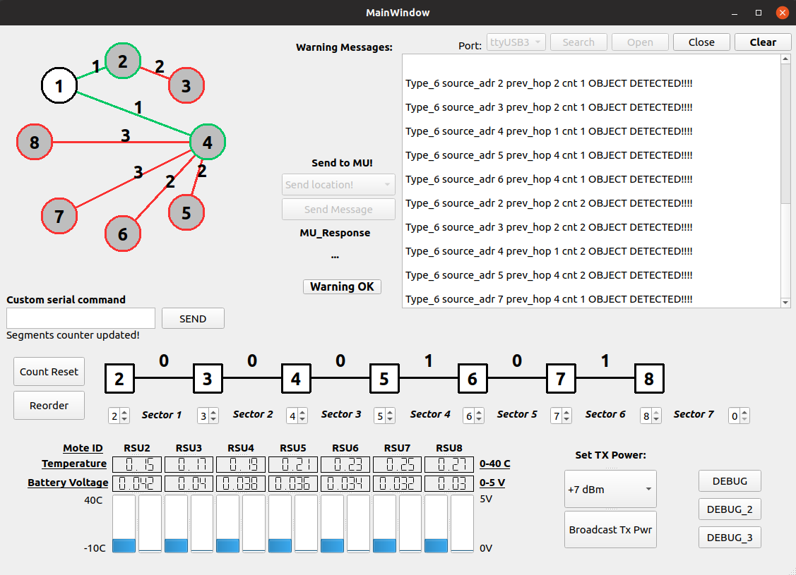
Graphical User Interface
Kellerer, Wolfgang, Prof. Dr.-Ing. (TUM) | WSN Winter 18 | Final Project
19

Slide 45
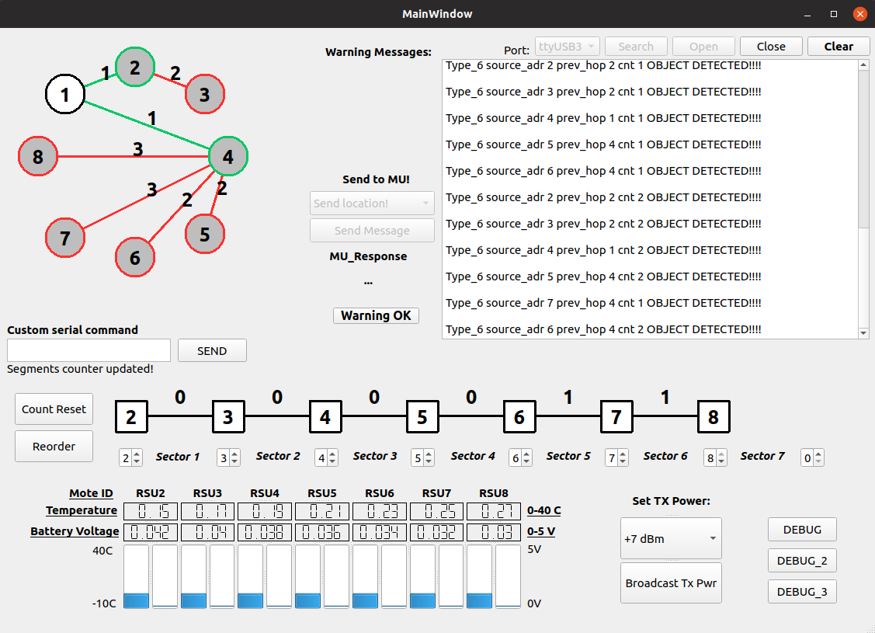
Graphical User Interface
Kellerer, Wolfgang, Prof. Dr.-Ing. (TUM) | WSN Winter 18 | Final Project
19

Slide 46

Graphical User Interface
Kellerer, Wolfgang, Prof. Dr.-Ing. (TUM) | WSN Winter 18 | Final Project
19

Slide 47
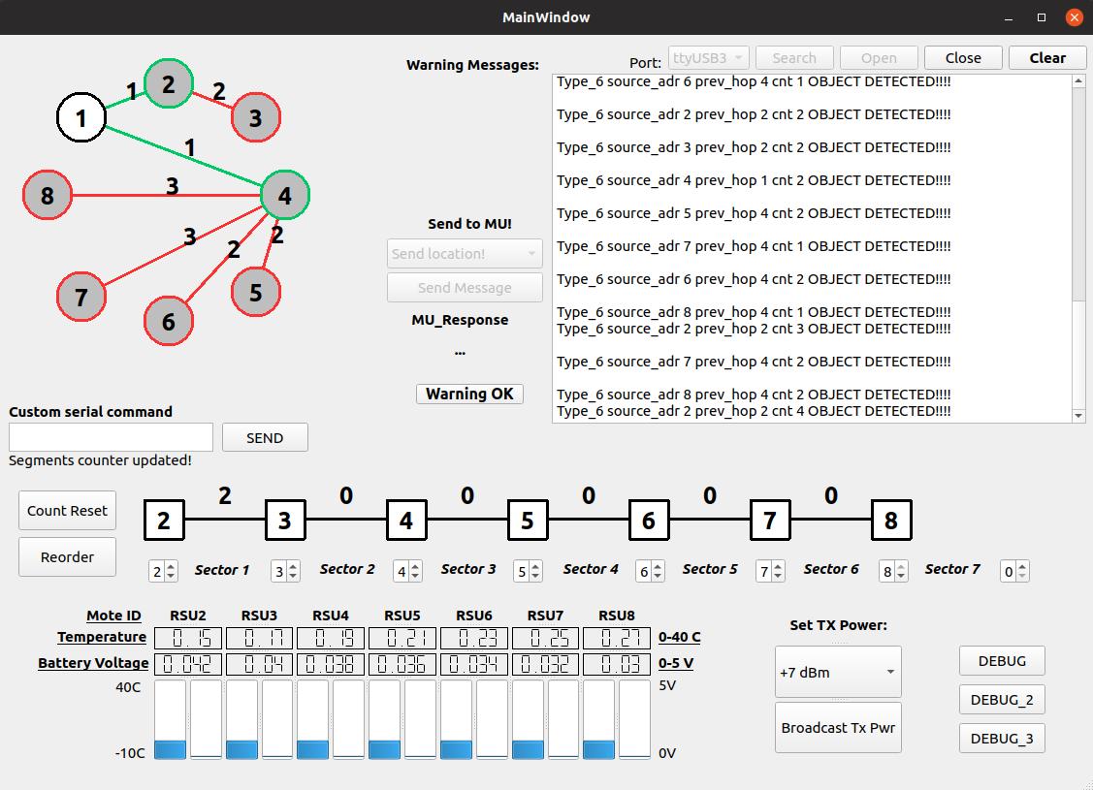
Graphical User Interface
Kellerer, Wolfgang, Prof. Dr.-Ing. (TUM) | WSN Winter 18 | Final Project
19

Slide 48
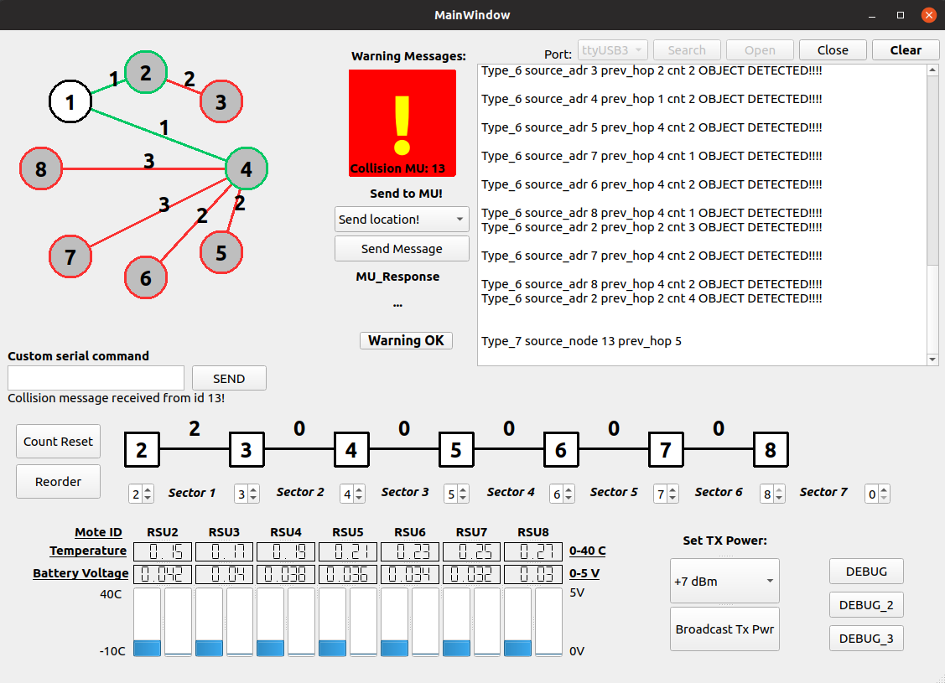
Graphical User Interface
Collision warning
Send message to collided MU enabled
Kellerer, Wolfgang, Prof. Dr.-Ing. (TUM) | WSN Winter 18 | Final Project
19

Slide 49
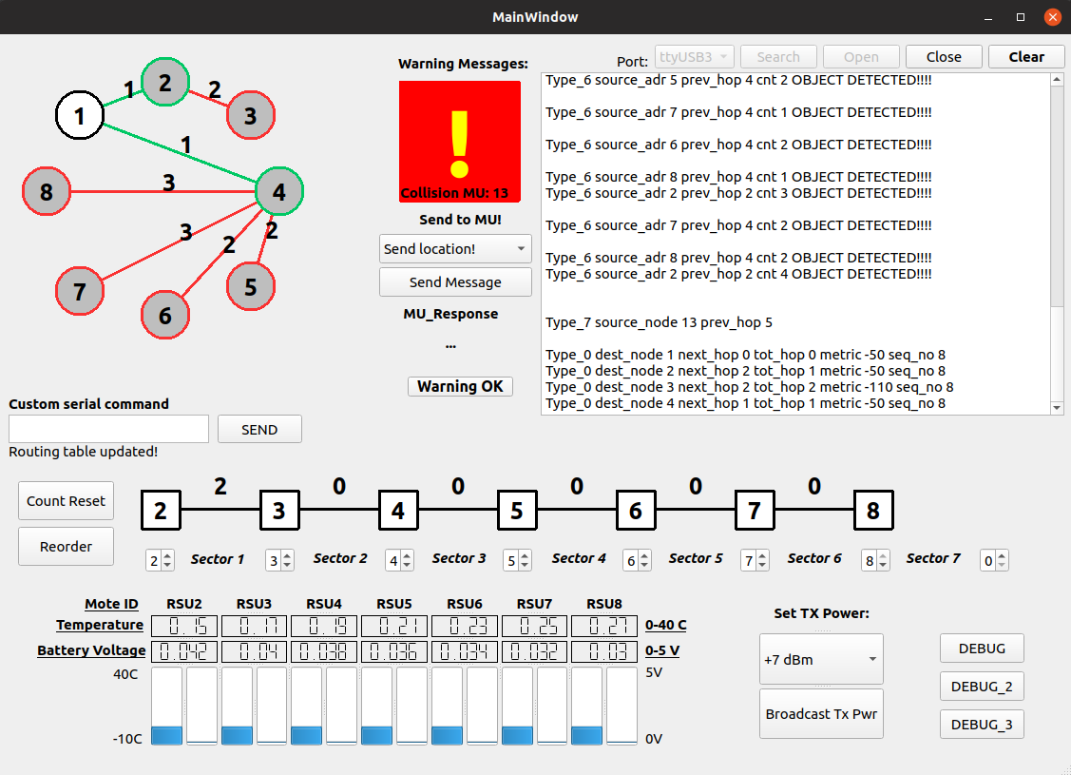
Graphical User Interface
Most probable sector of collision
Kellerer, Wolfgang, Prof. Dr.-Ing. (TUM) | WSN Winter 18 | Final Project
19

Slide 50
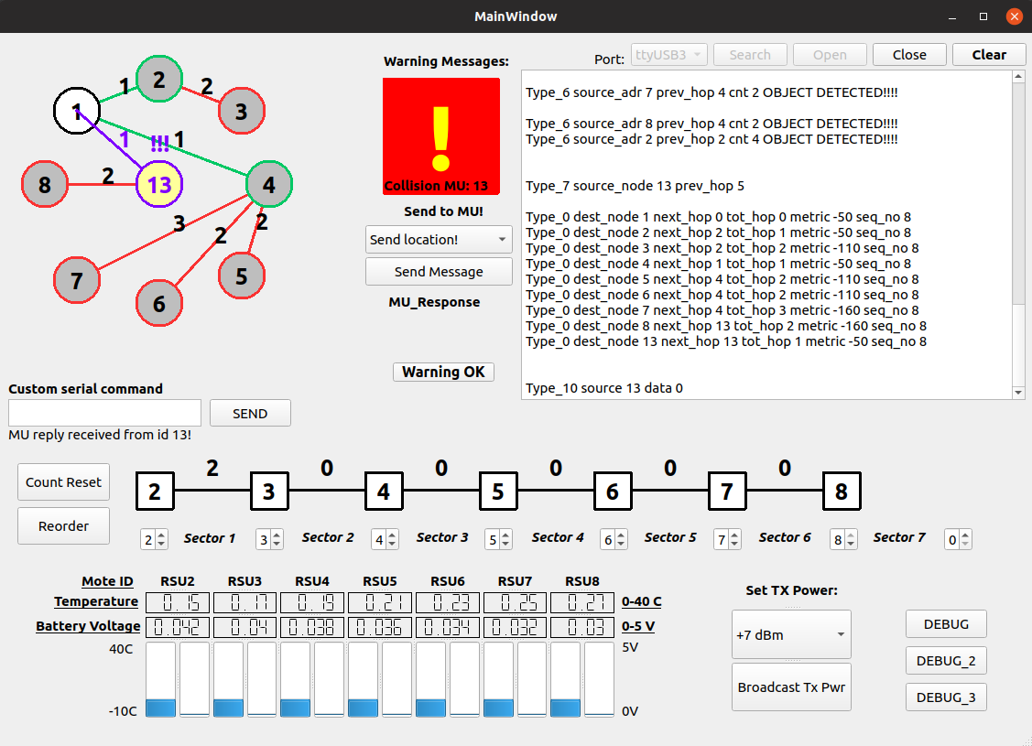
Graphical User Interface
Collided MU becomes part of the network
Kellerer, Wolfgang, Prof. Dr.-Ing. (TUM) | WSN Winter 18 | Final Project
19

Slide 51
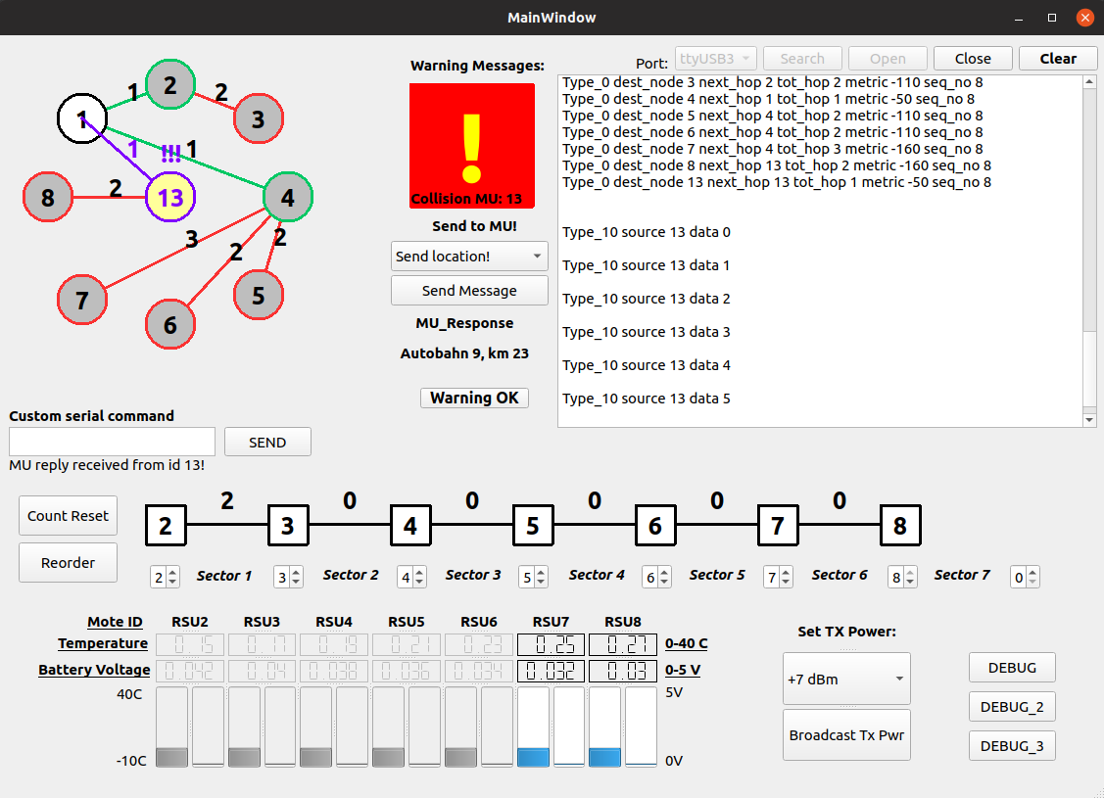
Graphical User Interface
Reply message from MU
Kellerer, Wolfgang, Prof. Dr.-Ing. (TUM) | WSN Winter 18 | Final Project
19

Slide 52
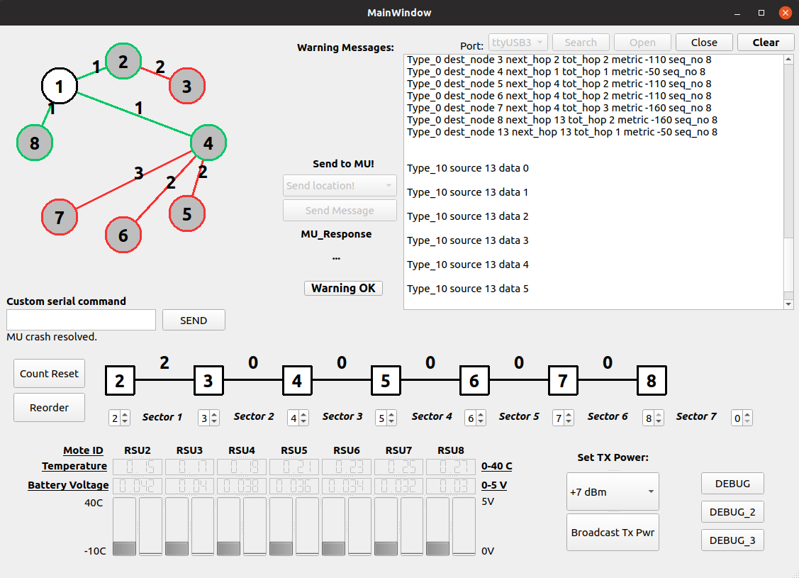
Graphical User Interface
Clear the collision after resolving it
Network removes the collided MU
Converges to normal routing mode
Kellerer, Wolfgang, Prof. Dr.-Ing. (TUM) | WSN Winter 18 | Final Project
19

Slide 53
Conclusion
DSDV routing algorithm was implemented in the transportation system by using wireless sensor networks.
Routing algorithm provides high reliability, low latency, failure recovery and emergency channel capabilities.
Emergency condition cases, e.g. car accidents are considered:
to warn other entities in the vicinity.
to communicate with the collided vehicle
RSUs provide an intuition to estimate traffic congestion on the road.
Road conditions e.g. temperature, can be monitored using data-logger.
Kellerer, Wolfgang, Prof. Dr.-Ing. (TUM) | WSN Winter 18 | Final Project
<number>

Slide 54
Demo ...
<number>

Slide 55

Questions?
<number>

Slide 56
References
G. Cookson and P. B, “Inrix global traffic scorecard,” INRIX Research, Tech. Rep., 2017.
B. für Straßenwesen (BASt) Federal Highway Research Institute, “Traffic and accident data - summary statistics - Germany,” Oct. 2018
T. Bhatia and A. Verma, “Qos comparison of manet routing protocols,” International Journal of Computer Network and Information Security, vol. 7, pp. 64–73, 08 2015.
<number>

